Slide 1



JAVA 8
1
Copyright © 2016. Cybage Software Pvt. Ltd. All Rights Reserved. Cybage Confidential.

Slide 2


Agenda
www.cybage.com
Introduction to new features of JAVA8
Lambda Expressions in JAVA8
Functional Interface and Method Reference
Interface Default and Static methods
The new Stream API and Collectors
Java 8 Date and Time API
Strings
5
Copyright © 2016. Cybage Software Pvt. Ltd. All Rights Reserved. Cybage Confidential.

Slide 3
Introduction to New JAVA8
www.cybage.com
Java 8 was a major release in terms of language and APIs.
Includes several ideas from functional programming like : lambda
stream API
i.
ii.
6

Slide 4
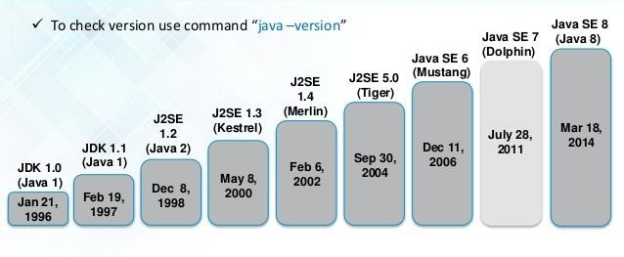
Evolution of JAVA 8
www.cybage.com
7

Slide 5
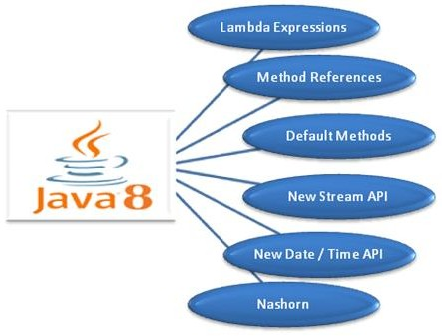
www.cybage.com
New JAVA 8!!

Slide 6
Functional Interface
www.cybage.com
An interface with exactly one abstract method becomes Functional
Interface.
@FunctionalInterface annotation is a facility to avoid accidental addition of abstract methods in the functional interfaces.

Slide 7
Functional Interface
www.cybage.com
Functional Interface can be annotated and its optional.
@FunctionalInterface
public interface MyfunctionalInterface{ someMethod();
};
Its just for the convenience , compiler can tell whether the interface is functional or not.

Slide 8
Valid Examples of Functional Interface
www.cybage.com
public interface Runnable{
run();
};
public interface Comparator<T>{
int compare(T t1 ,T t2);
};

Slide 9

LAMDA EXPRESSION

Slide 10
Advantages Lambda Expression
www.cybage.com
Enables functional programming
Readable and more concise code
Easier to use API
Enable support for parallel processing

Slide 11
Lambda Expression
www.cybage.com
It’s an anonymous function
It comprises of:
set of parameters,
a lambda operator (->) and
a function body.
(set of parameters) -> function body;

Slide 12
Valid Lambda Expressions
www.cybage.com
n -> n % 2 != 0;
(char c) -> c == 'y';
(x, y) -> x + y;
(int a, int b) -> a * a + b * b; () -> 42 () -> { return 3.14 };
(String s) -> { System.out.println(s); };
() -> { System.out.println("Hello World!"); };

Slide 13
Functional Interface
www.cybage.com
An interface with exactly one abstract method becomes Functional
Interface.
@FunctionalInterface annotation is a facility to avoid accidental addition of abstract methods in the functional interfaces.
A new package java.util.function has been added with bunch of functional interfaces to provide target types for lambda expressions and method references.

Slide 14
Four categories of Functional Interface
www.cybage.com
Inside Java.util.function we have 4 categories of interfaces:
1. Supplier
@FunctionalInterface
public interface Supplier<T>{
T get();
};
It takes an object and provide a new object.

Slide 15
Categories of Functional Interface
www.cybage.com
2. Consumer/BiConsumer
@FunctionalInterface
public interface Consumer<T>{ void accept(T t);
};
Its reverse of Supplier, it accepts an object but doesn't return anything.
@FunctionalInterface
public interface BiConsumer< T , U >{ void accept( T t , U u );
};
This also accepts the object of different type.

Slide 16
Categories of Functional Interface
www.cybage.com
3. Predicate/BiPredicate
@FunctionalInterface
public interface Predicate< T >{
boolean test( T t );
};
This method accept an Object and returns a boolean.
@FunctionalInterface
public interface BiPredicate< T t , U u>{ boolean test( T t , U u);
};
This method accepts two objects of different type and returns a boolean.

Slide 17
Categories of Functional Interface
www.cybage.com
4. Function/BiFunction
@FunctionalInterface
public interface Function < T , R >{ R apply( T t );
};
Represents a function that accept one arguments (T ) and produces a result (R)
@FunctionalInterface
public interface BiFunction < T , U , R >{
R apply( T t ,U u );
};
Represents a function that accepts two arguments (T , U) and produces a result (R)

Slide 18
Default Methods in Interface
www.cybage.com
Java 8 introduces “Default Method” or (Defender methods) new feature, which allows Interface to define implementation to methods which will be used as default in the situation where a
concrete Class fails to provide an implementation for that method.
public interface OldInterface {
public void existingMethod();
default public void newDefaultMethod() { System.out.println("New default method"
+ " is added in interface");
}
}

Slide 19
Stream API – Java 8 Feature
Stream API – Java 8 Feature
The Stream API is used to process collections of objects.
A stream is a sequence of objects that supports various methods which can be pipelined to produce the desired result.
Each intermediate operation is lazily executed and returns a stream as a result, hence
various intermediate operations can be pipelined.
Following are the different operations On Streams-
Intermediate Operations: Terminal Operations:
map filter sorted
collect forEach reduce
www.cybage.com

Slide 20
Stream API – Java 8 Feature
Stream API – Java 8 Feature
map :
List number = Arrays.asList(2,3,4,5);
List square = number.stream().map(x->x*x).collect(Collectors.toList());
filter :
List names = Arrays.asList("Reflection","Collection","Stream");
List result = names.stream().filter(s->s.startsWith("S")).collect(Collectors.toList());
sorted:
List names = Arrays.asList("Reflection","Collection","Stream");
List result = names.stream().sorted().collect(Collectors.toList());
www.cybage.com

Slide 21
Stream API – Java 8 Feature
Stream API – Java 8 Feature
collect:
List number = Arrays.asList(2,3,4,5,3);
Set square = number.stream().map(x->x*x).collect(Collectors.toSet());
forEach:
List number = Arrays.asList(2,3,4,5);
number.stream().map(x->x*x).forEach(y->System.out.println(y));
reduce:
List number = Arrays.asList(2,3,4,5);
int even = number.stream().filter(x->x%2==0).reduce(0,(ans,i)-> ans+i);
www.cybage.com

Slide 22

DEMO
Copyright © 2016. Cybage Software Pvt. Ltd. All Rights Reserved. Cybage Confidential.

Slide 23
Terminal operations
www.cybage.com
Function | Output | When to use
reduce | concrete type | to cumulate elements
collect | list, map or set | to group elements
forEach |  | Consumes data

Slide 24
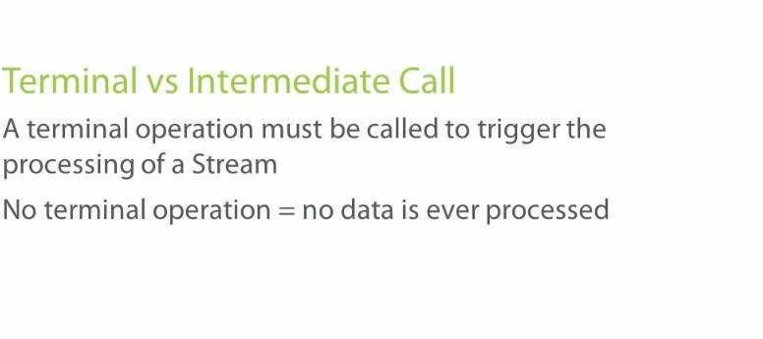
www.cybage.com
Terminal Vs Intermediate Call

Slide 25

Date and Time API
www.cybage.com
LocalDate
LocalTime and
LocalDateTime
Duration
Period
ZonedDateTime

Slide 26
Strings in Java 8
www.cybage.com
StringJoiner : used to construct a sequence of characters separated by a delimiter and optionally starting with a supplied prefix and ending with a supplied suffix.
Streaming a String : chars() creates a stream for all characters of the string
eg -> "hey duke".chars().forEach(c -> System.out.println((char)c));

Slide 27

Any Questions?

Slide 28

Thank you!
32
Copyright © 2016. Cybage Software Pvt. Ltd. All Rights Reserved. Cybage Confidential.

